Slide 1



Intelligent Home Energy Management With Power Consumption
FYP Proposal
Taha Saeed | (2133-2021)
M.Khizer Mallick | (2240-2021)
M.Shoaib Azam | (2172-2021)
Supervisor
Dr. Umer Farooq
Co-Supervisor
Dr. Rashid Hussain

Slide 2
Outline
2
Group Introduction
Problem Statement
Project Objectives
Project Scope
Architectural Big Picture
Methodology
Role & Responsibility
Project Milestones
Project Plan (Time lines)
Project Budgeting
Project Tools
Project Deliverables
Intelligent Home Energy Management With Power Consumption
CS-FYP Hamdard University
Project name here

Slide 3
Group Introduction
3
Group Members
Taha Saeed
M.Khizer Mallick
M.Shoaib Azam
Supervisor: Dr. Adnan Ahmed Siddique
Why we selected him as supervisor?
We selected Dr. Adnan Ahmed Siddique because of his vast experience and solid academic background to supervise our project on integrating green energy monitoring into a smart home energy management system. Having worked in the industry for 15 years and earned a Ph.D. in computer science, he is well-versed in the technologies and techniques required. Dr. Siddique has demonstrated a sincere interest in our work and made creative recommendations to improve the undertaking. He is the ideal mentor for our project because of his knowledge and capacity to improve our concepts.
Relevant Expertise
He has experience in similar domain and industry project which is related to our project.
Relevant Experience
He has 15+ years of prolific experience in academia and IT industry.
Sentimental Analysis during Video Conference
Sentimental Analysis during Video Conference
Sentimental Analysis during Video Conference
Intelligent Home Energy Management With Power Consumption
CS-FYP Hamdard University
Project name here
Project name here

Slide 4
Problem Statement
4
“You cannot manage what you cannot measure.”
— Peter Drucker —
Homeowners want to save energy and reduce electricity bills but they facing challenges in managing and monitoring their electricity consumption in real-time. Using too much electricity bills which also strains the power grid.
Current system does not have the ability to alert homeowners before they exceed their desired limit of electricity units.
The goal is to develop a Real-Time Smart Home Energy Monitoring and Management System that measures energy consumption in units using different analysis method and alert the homeowner if they might exceed the given limit.
The system can also switch automatically to different energy sources such as rooftop solar system or generator so decrease electricity consumption from the grid.
Sentimental Analysis during Video Conference
Sentimental Analysis during Video Conference
Sentimental Analysis during Video Conference
Intelligent Home Energy Management With Power Consumption
CS-FYP Hamdard University
Project name here
Project name here
Project name here
Project name here

Slide 5
Project Objectives
5
1. To design energy management and monitoring system:
Develop a smart household electricity consumption monitoring system, aiming to enhance . efficiency and reduce costs of electricity bills through notifications and recommendations
2. Smart Energy management alerts:
Take control of energy consumption and save our bills by optimizing how we use electricity. It can suggest actions when consumption reaches 170 units it considers implementing energy-saving measures like turning off extra appliances. At 180 units, it starts preferring alternative energy sources like solar or generators to reduce the speed by which units consumed are increasing. And if we hit 190 units, it strongly advices user to limit their electricity use to keep the bill under budget.
3. Predictive energy Analytics:
Utilize an AI predictive algorithm to predict future consumption of electricity based on historical data, weather and solar generation.
4. User friendly interface:
Ensure a user-friendly interface which allows homeowners to customize their app according to their wants and needs. The interface will be made available for both android and IOS.
Sentimental Analysis during Video Conference
Sentimental Analysis during Video Conference
Sentimental Analysis during Video Conference
Intelligent Home Energy Management With Power Consumption
CS-FYP Hamdard University
Project name here
Project name here
Project name here
Project name here
Project name here

Slide 6
Project Scope
6
The final year project will involve designing and developing a smart home energy management system. The system will aim to optimize energy usage within a household by integrating smart devices and sensors to monitor and control energy consumption. The project will include the development of a user-friendly interface for homeowners to track their energy usage, set preferences, and receive recommendations for energy-saving practices. The scope will encompass research, design, implementation, testing, and documentation of the smart home energy management system.
Sentimental Analysis during Video Conference
Sentimental Analysis during Video Conference
Sentimental Analysis during Video Conference
Sentimental Analysis during Video Conference
CS-FYP
Hamdard University
Intelligent Home Energy Management With Power Consumption
CS-FYP Hamdard University
Project name here
Project name here
Project name here
Project name here
Project name here

Slide 7
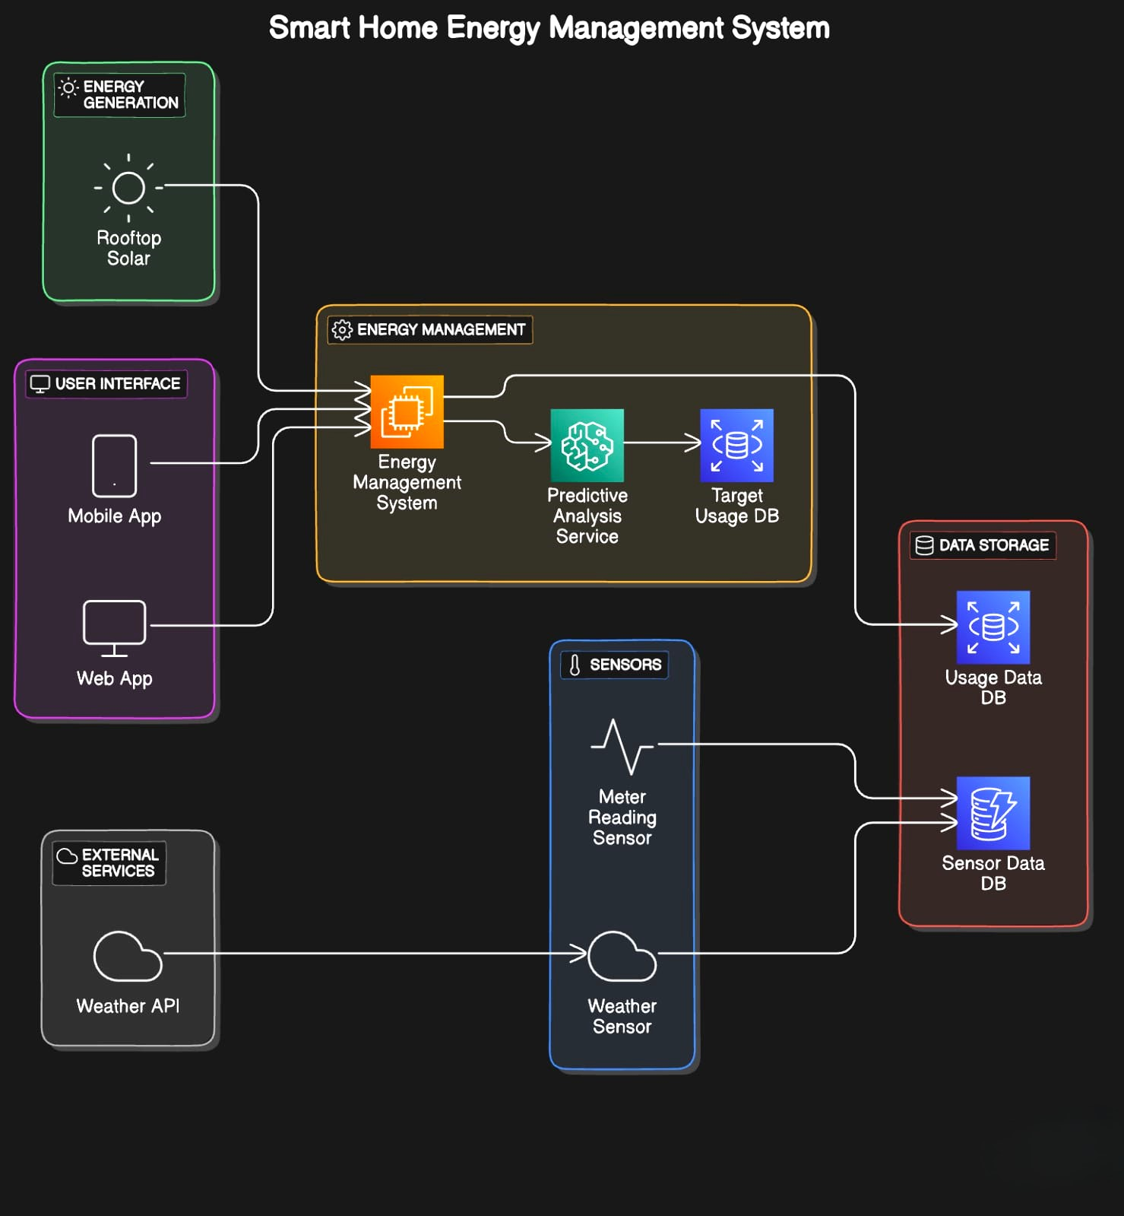
Architecture Big Picture
7
Sentimental Analysis during Video Conference
Sentimental Analysis during Video Conference
Sentimental Analysis during Video Conference
Intelligent Home Energy Management With Power Consumption
CS-FYP Hamdard University
Project name here
Project name here
Project name here
Project name here
Project name here

Slide 8
Project Methodology
8
Methodology:
The project will employ a hybrid methodology that blends Agile and Waterfall techniques. By ensuring a balanced development process, this method makes it easier to create an intuitive user interface for monitoring energy consumption, customizing preferences, and getting energy saving advice.
Waterfall:
In order to lay a strong basis for the system, the first planning and design stages will employ an organized Waterfall methodology. This will include integrating smart devices and sensors for energy monitoring and control.
Agile:
Agile iterations will then be used for the project's implementation and testing phases, enabling flexibility, ongoing feedback, and change adaption.
Sentimental Analysis during Video Conference
Sentimental Analysis during Video Conference
Sentimental Analysis during Video Conference
Sentimental Analysis during Video Conference
Intelligent Home Energy Management With Power Consumption
CS-FYP Hamdard University
Project name here
Project name here
Project name here
Project name here
Project name here

Slide 9
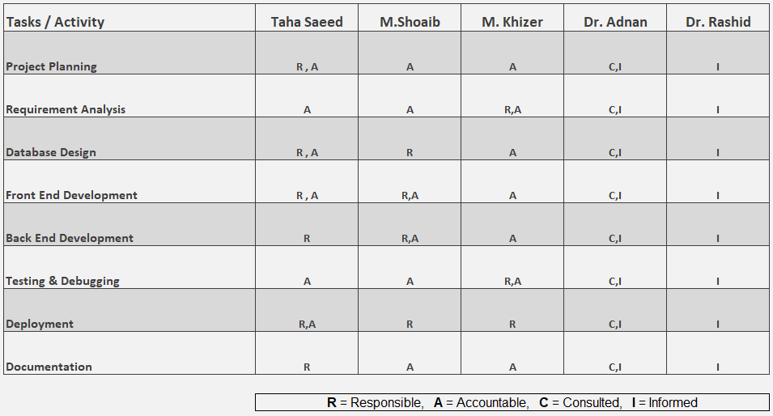
Project Role & Responsibilities
9
RACI Chart
Sentimental Analysis during Video Conference
Sentimental Analysis during Video Conference
Sentimental Analysis during Video Conference
Intelligent Home Energy Management With Power Consumption
Project name here
Sentimental Analysis during Video Conference
CS-FYP Hamdard University
Project name here
Project name here
Project name here
Project name here
CS-FYP
Hamdard University

Slide 10
Project Milestones
10
Planning (Create a detailed project timeline and budget)
Literature review (Study existing research on smart home energy management and monitoring system)
Algorithm selection (Choose algorithm for energy management and monitoring)
Feature extraction (Extract relevant features from collected data such as energy consumption patterns)
Model building (Develop a model to monitor energy consumption)
Model training (Train the model using data to ensure its efficiency, accuracy and reliability)
Real-time integration (Integrate into the real time system. The model should be capable of monitoring and managing energy usage.)
Sentimental Analysis during Video Conference
Sentimental Analysis during Video Conference
Sentimental Analysis during Video Conference
Intelligent Home Energy Management With Power Consumption
Project name here
Sentimental Analysis during Video Conference
CS-FYP Hamdard University
Project name here
Project name here
Project name here
Project name here
Project name here
CS-FYP
Hamdard University

Slide 11
Project Milestones
11
Designing(Designing a user-friendly interface for smart home energy management and monitoring system)
Testing (Test the smart home energy management and monitoring system for accuracy and reliability)
Deployment (Deploy the smart home energy management and monitoring in real world)
Maintenance (Monitor and update the smart home energy management and monitoring as needed)
Sentimental Analysis during Video Conference
Sentimental Analysis during Video Conference
Sentimental Analysis during Video Conference
Intelligent Home Energy Management With Power Consumption
CS-FYP Hamdard University
Project name here
Project name here
Project name here
Project name here
Project name here

Slide 12
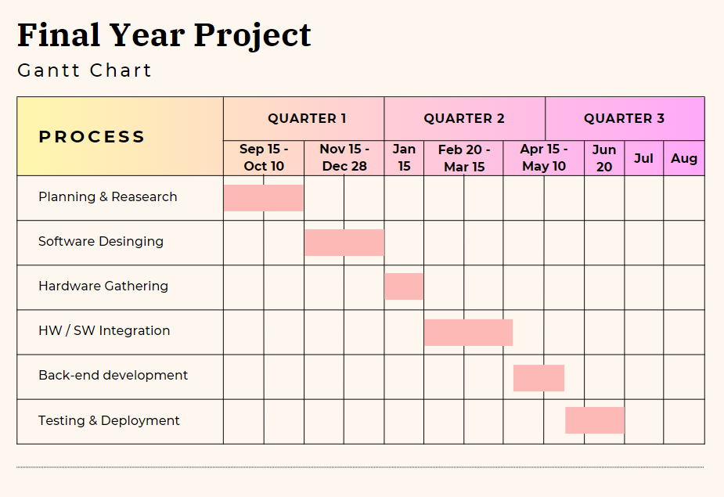
Project Plan
12
Sentimental Analysis during Video Conference
Sentimental Analysis during Video Conference
Sentimental Analysis during Video Conference
Intelligent Home Energy Management With Power Consumption
CS-FYP Hamdard University
Project name here
Project name here
Project name here
Project name here
Project name here

Slide 13
Project Budgeting
13
Estimated budget of project major resources
Hosting:
Hosting on Google Play Store | 25 $ One Time Hosting on Apple App store | 99 $ Per Year
Sensors:
Cameras |15000 x 2 Pkr
Temperature Sensor |5000 Pkr
Appliances:
Electric Meter |5000 Pkr
Desk Fan |1500 x 2 Pkr
Table Top Lamp |2500 x 3 Pkr
Total cost PKR 55,950 est.
*Detailed budget sheet will be provide.*
Sentimental Analysis during Video Conference
Sentimental Analysis during Video Conference
Sentimental Analysis during Video Conference
Intelligent Home Energy Management With Power Consumption
CS-FYP Hamdard University
Project name here
Project name here
Project name here
Project name here
Project name here

Slide 14
Project Tools
14
Software Requirements
Hardware Requirements
Google Collab / Visual Studio code
Python
MS SQL for databases
Tensor Flow
JavaScript
HTML
CSS
Laptop (Core, i5, 8GB, 500GB SSD)
External Backup Hard drives
Camera
Sensors
Bulb
Fan
Sentimental Analysis during Video Conference
Sentimental Analysis during Video Conference
CS-FYP
Hamdard University
Sentimental Analysis during Video Conference
Sentimental Analysis during Video Conference
Intelligent Home Energy Management With Power Consumption
CS-FYP Hamdard University
Project name here
Project name here
Project name here
Project name here
Project name here

Slide 15
8- Project Deliverables
15
FYP-I Evaluation
FYP-II Evaluation
SRS Document Budget Document WBS
Project Plan Design
Data Collection Interface Project Report - I
Survey Paper (First Draft)
UI Design Proposed System User Manual Source Code CD Project Report - II
Research Paper (First Draft)
Sentimental Analysis during Video Conference
Sentimental Analysis during Video Conference
CS-FYP
Hamdard University
Sentimental Analysis during Video Conference
Sentimental Analysis during Video Conference
Intelligent Home Energy Management With Power Consumption
CS-FYP Hamdard University
Project name here
Project name here
Project name here
Project name here
Project name here

Slide 16

16
THANK YOU!
Sentimental Analysis during Video Conference
Sentimental Analysis during Video Conference
Sentimental Analysis during Video Conference
Intelligent Home Energy Management With Power Consumption
CS-FYP Hamdard University
Project name here
Project name here
Project name here
Project name here
Project name here

